Slide 1
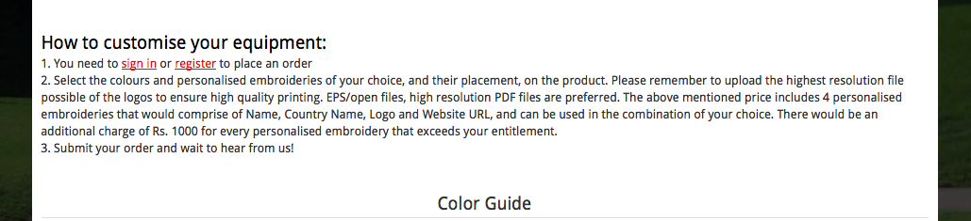
Step (Step 1, Step 2, Step 3)
To be checked for each product
optimum quality output

Slide 2
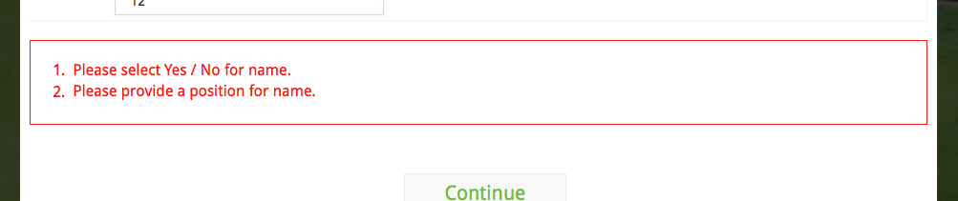
check Yes or No, as applicable for the presence of (the) name
(the) name

Slide 3
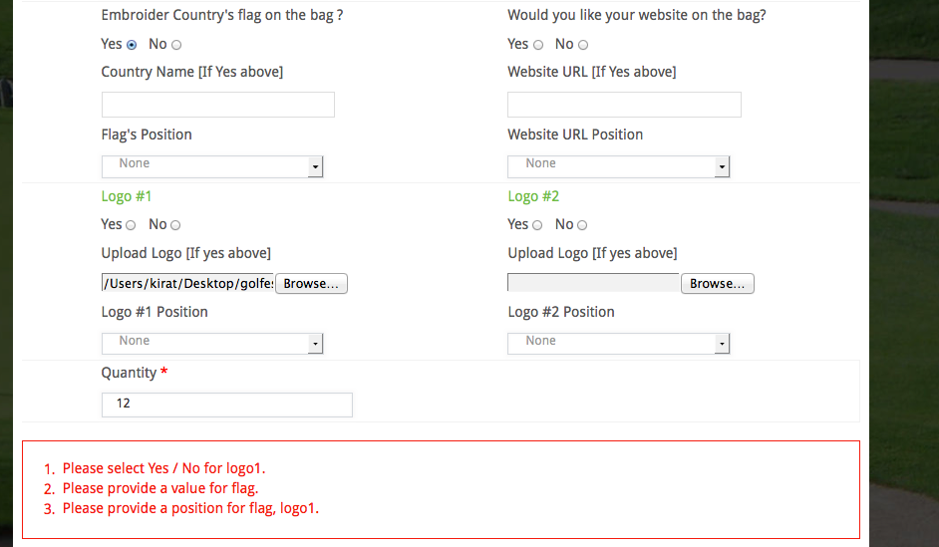
check Yes or No, as applicable for the presence of Logo #1/Logo1
fill in the field for flag
(the) Flag & Logo #1/Logo1

Slide 4
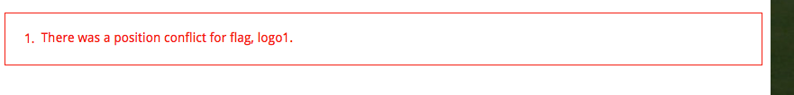
for the placement of (the) Flag & Logo #1/Logo1

Slide 5
Error Messages and notes
On selecting more than the possible number of embroideries:
Sorry, you can only select __ customised embroideries on this product DONE
On entering a quantity less than the minimum order:
Sorry, the minimum order is ___ DONE
Note to be added where Price on request is mentioned:
(The price depends on the quantity and the complexity of the embroideries. You will be informed of the price shortly after you place your order. You will then have the option to confirm or cancel your order.) DONE

Slide 6
Error Messages in case Yes or no is not selected
Please check Yes or No, as applicable for the presence of
the name
the country flag
the website URL
Logo #1/#2…
on the bag

Slide 7
Error Messages in case Yes is selected and no other information is entered
Please enter/Please fill in the field for
the name
the country name
the website URL
Please upload
Logo #1/#2…
Please provide a position for
the name
the country flag
the website URL
Logo #1/#2…
on the bag

Slide 8
In case of a position conflict (this should not appear if the user has exceeded the max no. of embroideries)
There was a position conflict for the placement of
the name &/
the country flag &/
the website URL&/
Logo #1/
Logo #2/….
on the bag

Slide 9
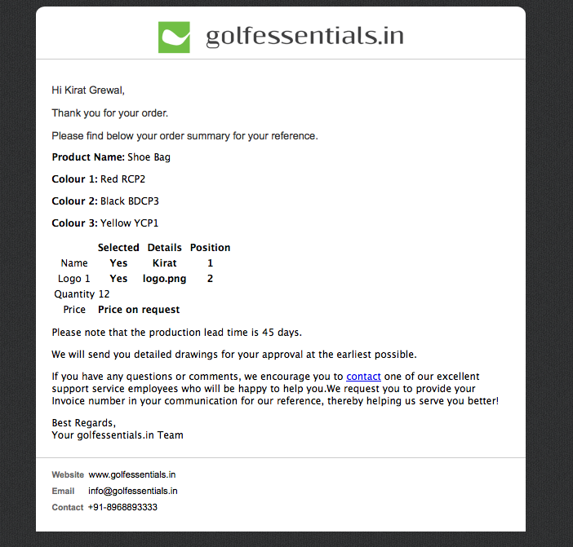
In case of price on request, please add the copy that I’ve put in green
This should be in bold as well
(We will get back to you shortly on this)
from the day you confirm your order.
shortly after we receive your confirmation on the price
add space

Slide 10
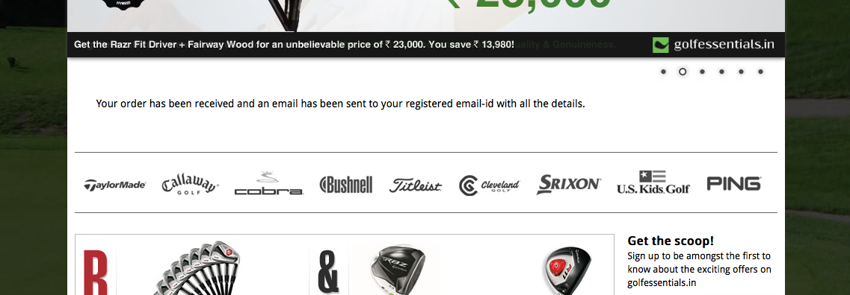
successfully placed
email ID with the order summary

